Slide 1

PROJECT PHASE - 1
Review - 1
"AI-Powered Framework for Diagnosis of Medical Conditions"
(Using x-ray images)
PRESENTED BY
Harshitha R (ENG21CT0008)
Sowmya LG (ENG21CT0017)
Raja kumar (ENG21CT0033)
Tharun V (ENG22CT1003)
Under the Guidance of
Prof.M. Chithambarathanu
Assistant Professor
Dept. of Computer Science Technology

Slide 2
ABSTRACT
The early detection of diseases is crucial for timely medical intervention and improved patient outcomes. In this project, we present a machine learning-based system for automatic disease detection from X-ray images. The integration of machine learning (ML) and deep learning (DL) techniques in medical imaging, particularly X-ray analysis, has shown significant promise in enhancing early disease detection. This presentation explores the application of convolutional neural networks (CNNs) and other ML methodologies to accurately identify various diseases from X-ray images. By leveraging large datasets and advanced algorithms, we aim to improve diagnostic accuracy and efficiency, ultimately contributing to better patient outcomes. This work emphasizes the importance of feature extraction, data preprocessing, and model validation in creating robust ML models capable of assisting healthcare professionals in clinical settings.
DEPARTMENT OF CST (SOE), DAYANANDA SAGAR UNIVERSITY

Slide 3
INTRODUCTION
In this project, we explore the potential of machine learning (ML) and artificial intelligence (AI) to aid in the early detection of diseases from X-ray images.
By developing a robust AI-powered system, we aim to assist healthcare professionals in diagnosing conditions with greater speed, accuracy, and consistency.
Using advanced deep learning techniques, particularly Convolutional Neural Networks (CNNs), we will train models to identify patterns and anomalies in X-ray images that may indicate the presence of diseases like pneumonia, tuberculosis, and lung cancer.
Traditional analysis methods often rely on radiologists' expertise; however, the increasing volume of imaging data necessitates automated solutions
Through this project, we aim to demonstrate the capability of machine learning to enhance radiological practices, ultimately improving patient outcomes by enabling earlier and more accurate disease detection.
DEPARTMENT OF CST (SOE), DAYANANDA SAGAR UNIVERSITY

Slide 4
Literature Survey
Study | Methodology | Findings | Conference | Link
Explainable AI in Medical Imaging (2023) | Incorporation of Explainable AI Techniques | Enhanced trust among radiologists by providing interpretable results alongside predictions | IEEE International Conference on Data Mining (ICDM) | Wiley Online Library
Deep Learning for Lung Cancer Detection (2021) | Incorporation of Explainable AI Techniques | Achieved a specificity rate of 90% in lungcancer identification from CT scans adapted for X-ray analysis | European Conference on Computer Vision (ECCV) | SpringerLi nk
Comparative Study on ML Algorithms (2023) | Comparison between CNN and traditional ML methods | CNNs outperformed traditional methods by a margin of 15% in diagnostic accuracy | International Joint Conference on Neural Networks (IJCNN) | MDPI
Automated Detection of Tuberculosis (2019) | CNN with Image AugmentationTechniques | Improved sensitivityto 92% for TB detection from chest X-rays using augmented datasets | International Conference on Computer Vision and Pattern Recognition (CVPR) | Elsevier
Literature Survey:
DEPARTMENT OF CST (SOE), DAYANANDA SAGAR UNIVERSITY

Slide 5
Contd.,
Machine Learning Applications Review (2022) | Various ML Techniques | Highlighted improvements in diagnostic performance over traditional methods with quantitative metrics | International Conference on Artificial Intelligence in Medicine (AIME) | Springer
Ensemble Models for DiseaseDetection (2024) | ResNet50, DenseNet121, Inception-ResN et-v2 | Demonstrated effective performance across diverse datasets with high accuracy rates | IEEE International Conference on Bioinformatics and Biomedicine (BIBM) | Nature
Deep Learning for Pneumonia Detection (2017) | CNN on Chest X-rays | Reported an AUC of 0.97 for pneumonia classification across multiple datasets | International Conference on Medical ImageComputing and Computer-Assisted Intervention (MICCAI) | IJISAE
Yabsera Erdaw et al. (2021) | SVM Classifier on CXR | Achieved 97% accuracy in COVID-19 detection using a dataset of 5,000 images | European Conference Computer Vision(ECCV) | NCBI
DEPARTMENT OF CST (SOE), DAYANANDA SAGAR UNIVERSITY

Slide 6

RESEARCH GAP
Our project addresses these gaps by integrating multi-modality analysis (X-ray and CT), incorporating explainability techniques, focusing on diverse and inclusive datasets, and ensuring real-world usability with healthcare system integration. By targeting these research gaps, the system can significantly advance the field of AI-driven early disease detection.
Limited Focus on Multi-Modality Analysis
Current Situation: Most existing systems are specialized for either X-ray or CT scans, rarely integrating both modalities in a single solution. This limits their ability to leverage complementary diagnostic information.
. Limited Emphasis on Rare Diseases
Current Situation: Existing models focus primarily on common diseases like pneumonia or COVID-19, often overlooking rare conditions due to insufficient data.
Lack of Continuous Learning Mechanisms
Current Situation: Most AI systems lack mechanisms to learn continuously from new data, which leads to outdated models over time.

Slide 7
PROBLEM STATEMENT
Timely and accurate diagnosis of diseases is critical for effective medical treatment. However, in many healthcare settings, particularly in resource-limited environments, there is a shortage of experienced radiologists, leading to delays and potential errors in interpreting X-ray images. Manual diagnosis of conditions such as pneumonia, tuberculosis, lung cancer, and fractures from X-rays can be time-consuming and prone to human error, especially when dealing with subtle or early-stage manifestations of diseases.
The primary challenge is to develop a system that can assist medical professionals by providing rapid, reliable, and early detection of diseases from X-ray images, reducing the burden on radiologists and improving diagnostic accuracy.
Thus, the problem is :
How can we leverage machine learning to automatically detect and classify diseases from X-ray images with high accuracy, reducing the risk of misdiagnosis?
How can we ensure that the AI system is interpretable, allowing clinicians to understand and trust the model's decisions?
DEPARTMENT OF CST (SOE), DAYANANDA SAGAR UNIVERSITY

Slide 8
EXISTING WORK
Traditional radiological analysis relies heavily on human expertise and subjective interpretation.
Initial machine learning models primarily utilized simpler algorithms like support vector machines (SVMs), decision trees, or logistic regression with limited success due to their inability to capture complex patterns within image data.
The reliance on expert radiologists can create bottlenecks in high-demand healthcare settings where timely diagnosis is critical.
DEPARTMENT OF CST (SOE), DAYANANDA SAGAR UNIVERSITY

Slide 9
PROPOSED METHODOLOGY
Implementing advanced convolutional neural network architectures specifically designed for image classification tasks.
Transfer Learning: Utilizing pre-trained models like VGG16 or ResNet50 can significantly reduce training time and improve performance when labelled data is scarce.
Hybrid Models: Developing hybrid models that combine multiple algorithms (e.g., CNNs with traditional machine learning classifiers like Random Forests or SVMs) can enhance accuracy by leveraging the strengths of each approach.
Feature Extraction Techniques: Employing techniques such as Histogram of Oriented Gradients (HOG), Local Binary Patterns (LBP), or deep feature extraction from intermediate layers of CNNs can improve model robustness
DEPARTMENT OF CST (SOE), DAYANANDA SAGAR UNIVERSITY

Slide 10
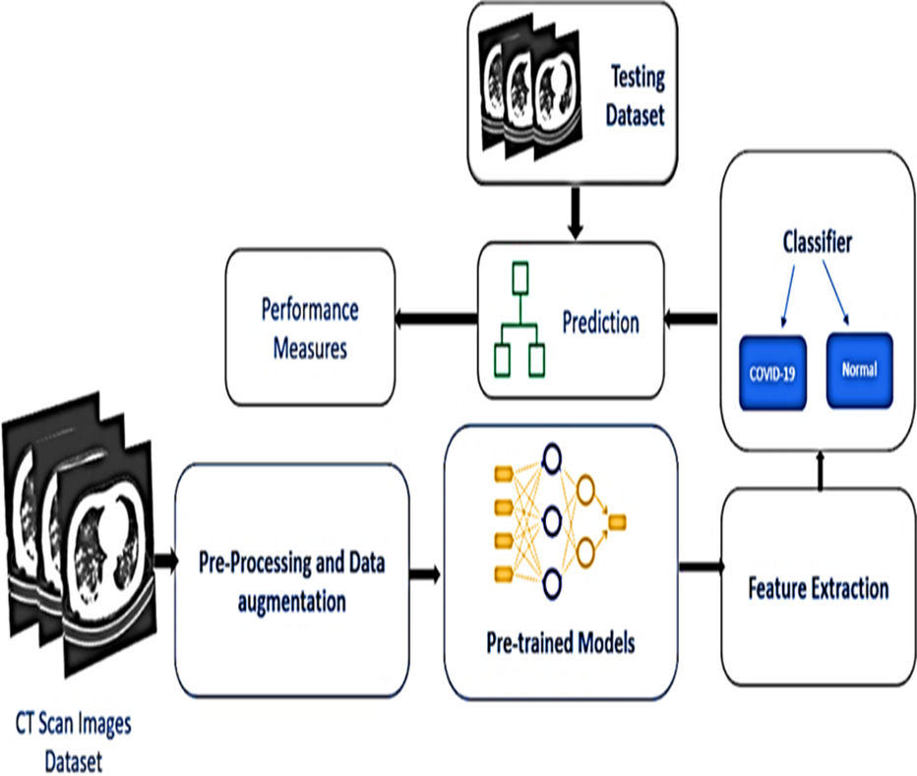
SYSTEM ARCHITECTURE
Architectural diagram
tuberculosis

Slide 11
PROOF OF CONCEPT:
Data Collection: Use a small subset of labelled X-ray and CT scan images (e.g., 500–1,000 images from CheXpert or LUNA16).
Preprocessing: Normalize, resize, and augment the images to improve input consistency and generalizability.
Model Selection: Train a simple Convolutional Neural Network (CNN) or pre-trained model (e.g., ResNet, DenseNet) on the labelled data.
Prediction: Evaluate the model's ability to classify diseases (e.g., pneumonia, tuberculosis) or detect abnormalities in the scans.
Explainability: Generate heatmaps using Grad-CAM to explain the model’s decisions and validate its predictions with a radiologist.
Integration: Build a prototype interface for clinicians to upload images and view predictions.

Slide 12
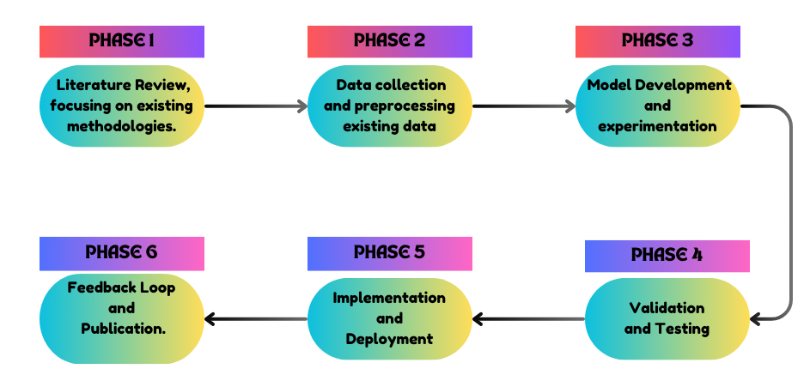
ROADMAP
DEPARTMENT OF CST (SOE), DAYANANDA SAGAR UNIVERSITY

Slide 13
CONCLUSION
Advanced machine learning techniques hold significant potential for improving early disease detection from X-ray images through automated analysis tools that complement radiologists' expertise. By integrating advanced algorithms such as CNNs into clinical workflows, healthcare providers can enhance diagnostic accuracy and efficiency while addressing challenges related to data variability and model generalization. Future research should focus on refining these models by incorporating explainable AI techniques that enhance interpretability and trust among medical professionals.
DEPARTMENT OF CST (SOE), DAYANANDA SAGAR UNIVERSITY

Slide 14
REFERENCES
Yabsera Erdaw et al., "Machine Learning Model Applied on Chest X-Ray Images Enables Automatic Detection of COVID-19 Cases with High Accuracy." NCBI
"Machine Learning for Early Detection of Pneumonia from Chest X-ray Images." IJISAE
"Generalizable disease detection using model ensemble on chest X-ray." Nature
"Machine learning and deep learning approach for medical image analysis." Springer
"Machine Learning Augmented Interpretation of Chest X-rays." NCBI
"Transfer Learning for Medical Image Classification Using Deep Learning." IEEE
"Automated Detection of Tuberculosis Using Deep Learning Techniques." Elsevier
"Comparative Study on Machine Learning Algorithms Applied to Chest X-Ray Images." MDPI
"Deep Learning Approaches for Lung Cancer Detection Using CT Scans." SpringerLink
"Explainable Artificial Intelligence Techniques Applied to Medical Imaging." Wiley Online Library
Shamrat, FM Javed Mehedi, Sami Azam, Asif Karim, Kawsar Ahmed, Francis M. Bui, and Friso De Boer. "High-precision mul-770 ticlass classification of lung disease through customized MobileNetV2 from chest X-ray images." Computers in Biology and 771 Medicine 155 (2023): 106646.
DEPARTMENT OF CST (SOE), DAYANANDA SAGAR UNIVERSITY

Slide 15
THANK YOU!!

